Slide 1
Credit Derivatives
Technology and General Services Department
Econometric and Modeling Support
Alexei Goumilevski
February 19th, 2015

Slide 2
Overview
Credit Default Swap
Collateralized Debt Obligations
Basel II Internal Ratings Based Approach
MatLab Demo

Slide 3
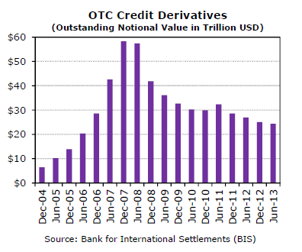
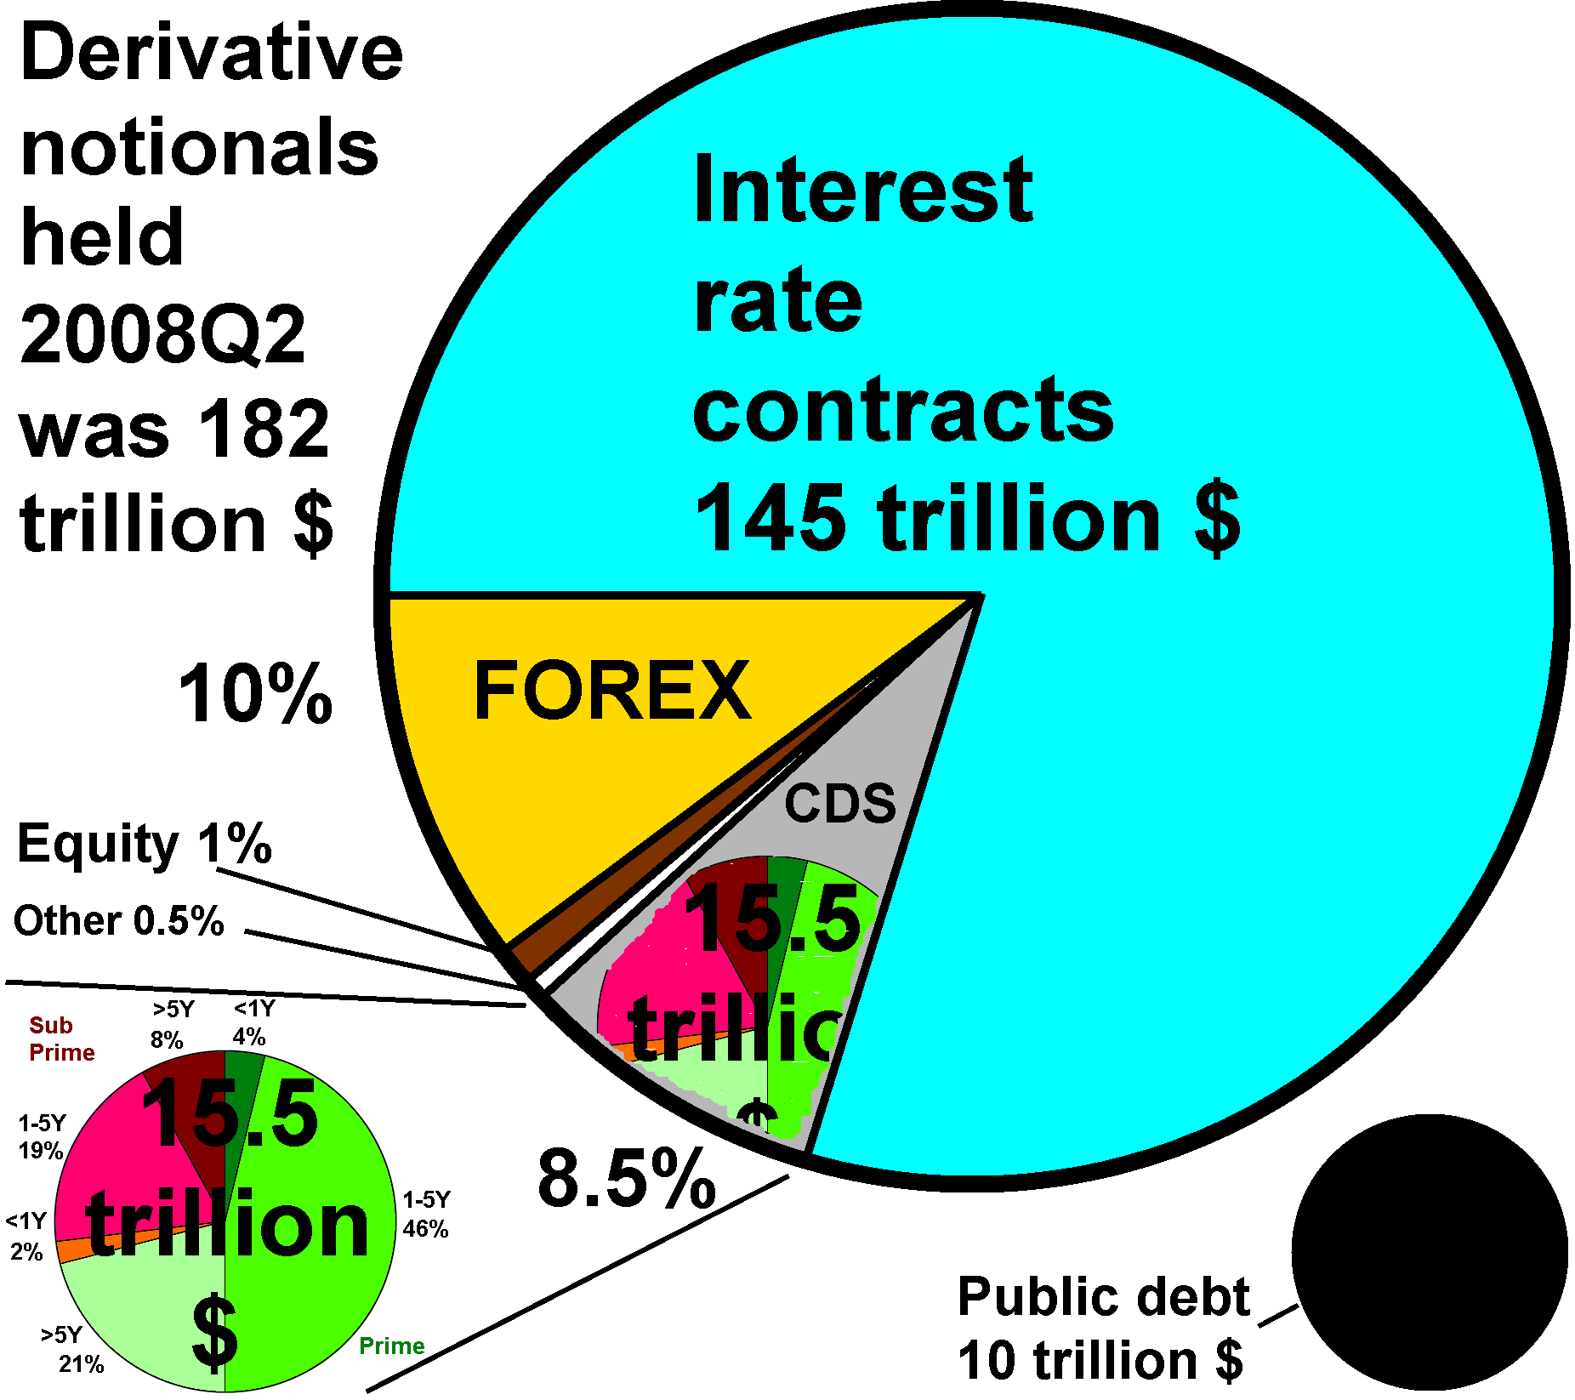
OTC Credit Derivatives Market Size

Slide 4
CDS Definition
In a standard credit default swap (CDS), a counterparty buys protection against default by a particular company or economic entity from a counterparty (seller).
The company or entity is known as the reference entity and a default by that entity is known as a credit event.
The buyer of the CDS makes periodic payments or a premium to the seller until the end of the life of the CDS or until the credit event occurs.
Depending on the contract, if the credit event occurs, the buyer has the right to sell a particular bond (or loan) issued by the company for its par value (physical delivery) or receive a cash settlement based on the difference between the defaulted bond’s par value and its market price (recovery value) .

Slide 5
Credit Event
Declared by International Swaps and Derivatives Association (ISDA) Determination Committee.
Credit event usually assumes one of the following:
Failure to meet payment obligations when due
Bankruptcy
Material adverse restructuring of debt
Ratings deterioration

Slide 6
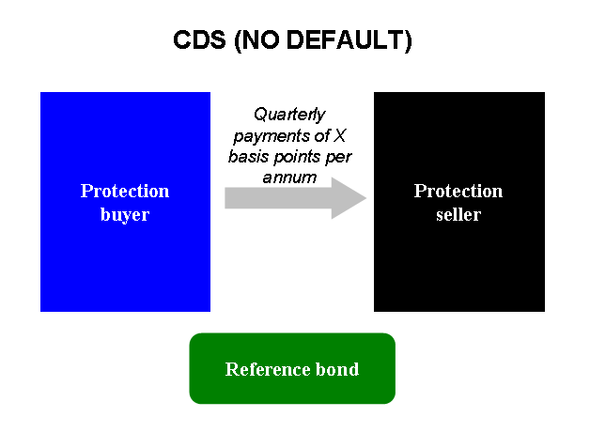
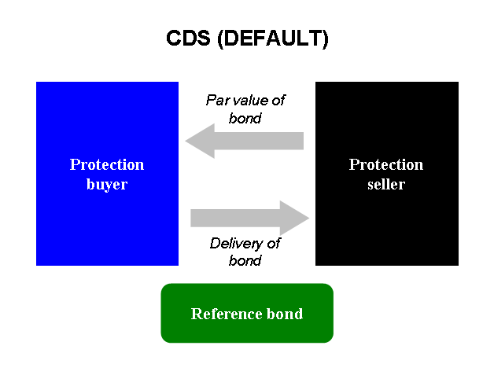
Credit Default Swap

Slide 7
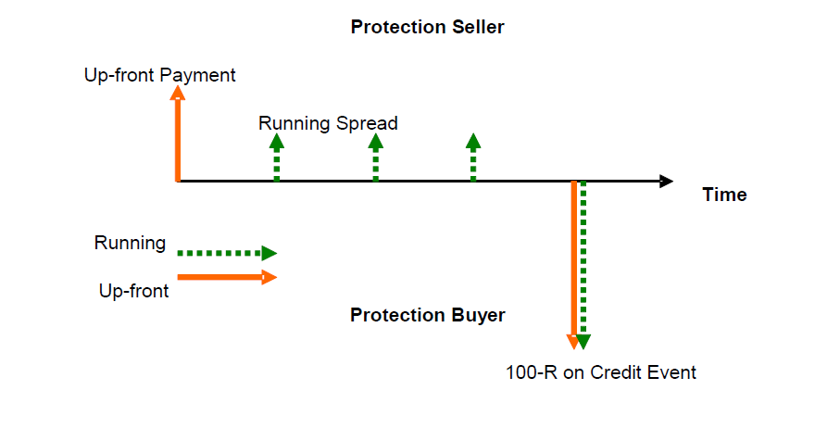
CDS Cash Flows

Slide 8
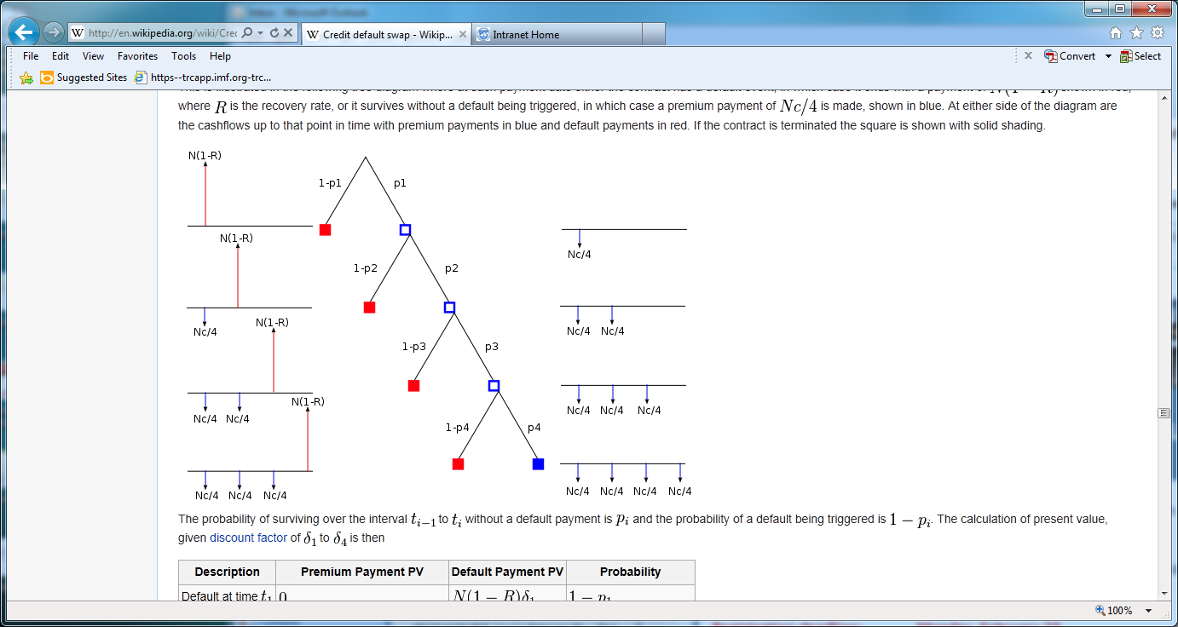
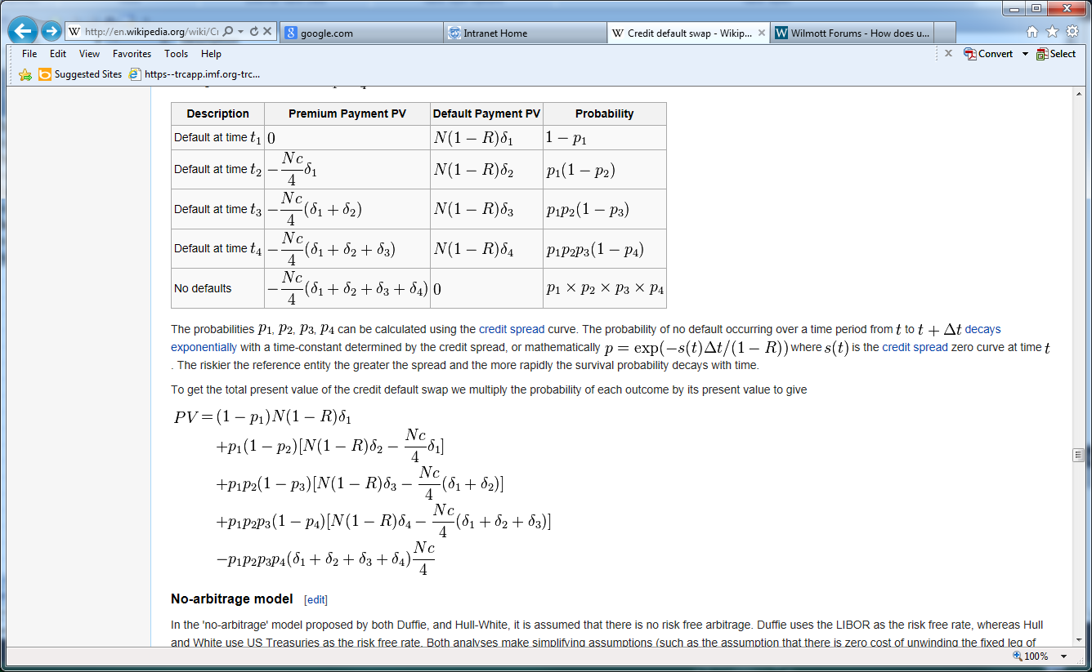
CDS Cash Flows

Slide 9
Net Present Value of CDS Cash Flows
Premium leg:
Default leg:
Net present value:
Breakeven spread:

Slide 10
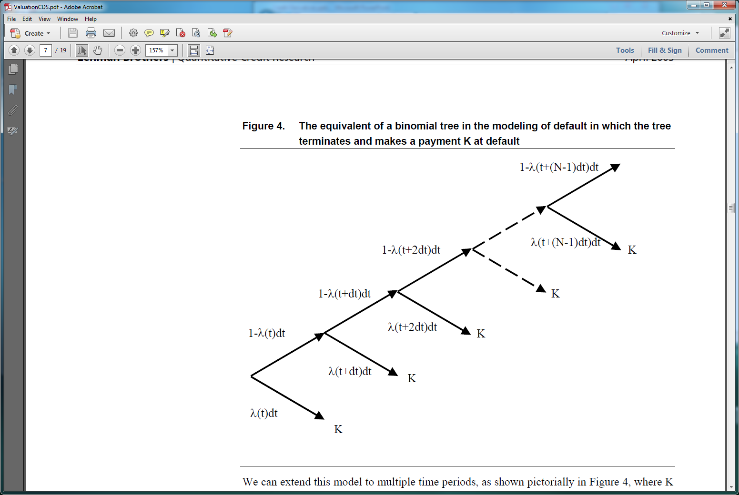
Reduced-Form Approach
Probability of default is described by a Poisson counting process:
Default Process can be represented by a binomial tree in which tree terminates and makes a payment K at default

Slide 11
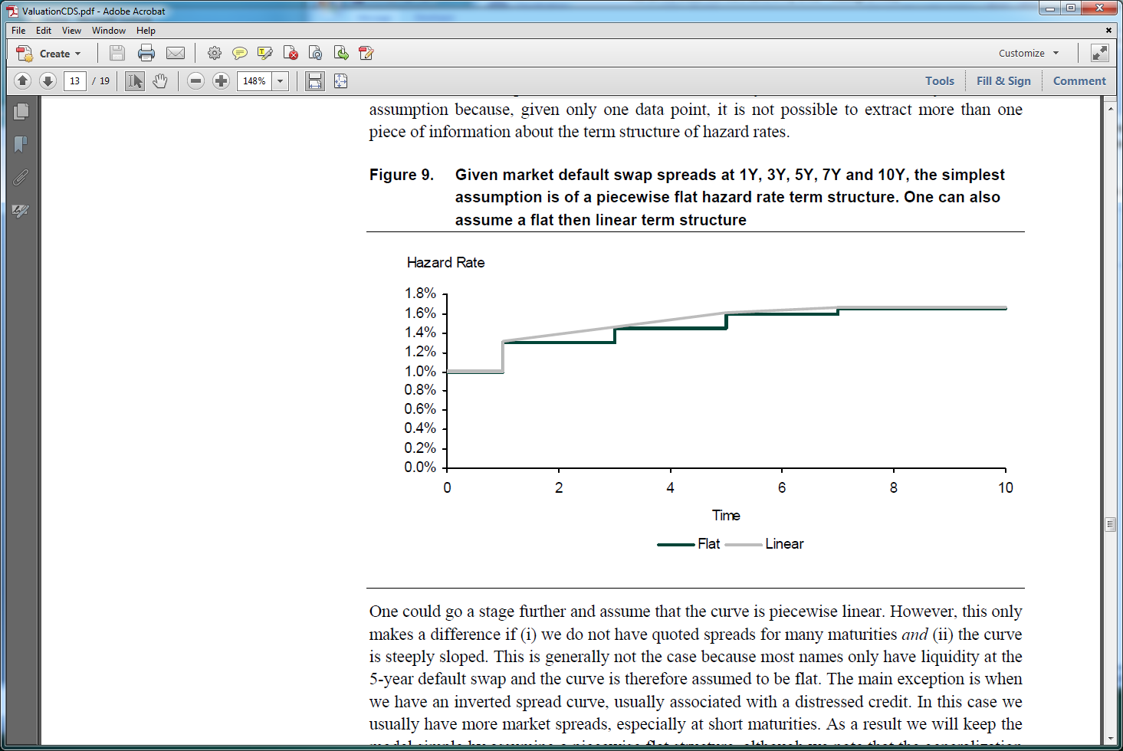
Reduced-Form Approach
Given the market default spreads at 1Y,2Y, 3Y, 5Y and 10Y one can apply a bootstrapping procedure to find hazard rate term structure:
Starting with the shortest maturity contract of 1Y calculate hazard rate for the first year
Proceed with 2Y contract and calculate hazard rate for the second year
Repeat until hazard rates for the longest contact are calculated

Slide 12
Sovereign Default Probabilities (from Deutsche Bank Research)
Country | 1 Yr CDS Spread (Bp) | 1 Yr PD
United States | 17 | 0.3%
Germany | 18 | 0.3%
China | 93 | 2%
Italy | 107 | 2%
Portugal | 179 | 3%
Brazil | 226 | 4%
Egypt | 309 | 5%
Russia | 583 | 10%
Ukraine | 2,795 | 47%
Argentina | 2,987 | 50%
Venezuela | 5,209 | 87%
Approximation: Spread = (1-R) * PD

Slide 13
Collateralized Debt Obligations
CDO is a security whose income payments and hence value is derived from and collateralized by a specified pool of underlying assets.
CDO is "sliced" into “tranches”, which "catch" the cash flow of interest and principal payments in sequence based on seniority.
If some loans default and the cash collected by the CDO is insufficient to pay all of its investors, those in the lowest, most "junior" tranches suffer losses first.
The last to lose payment from default are the safest, most senior tranches.
Consequently coupon payments (and interest rates) vary by tranche with the safest/most senior tranches paying the lowest and the lowest tranches paying the highest rates to compensate for higher default risk.
Synthetic CDO underlyings are comprised of CDS, and Cash CDO of loans.
Separate special purpose entities—rather than the parent investment bank—issue the CDOs and pay interest to investors.

Slide 14
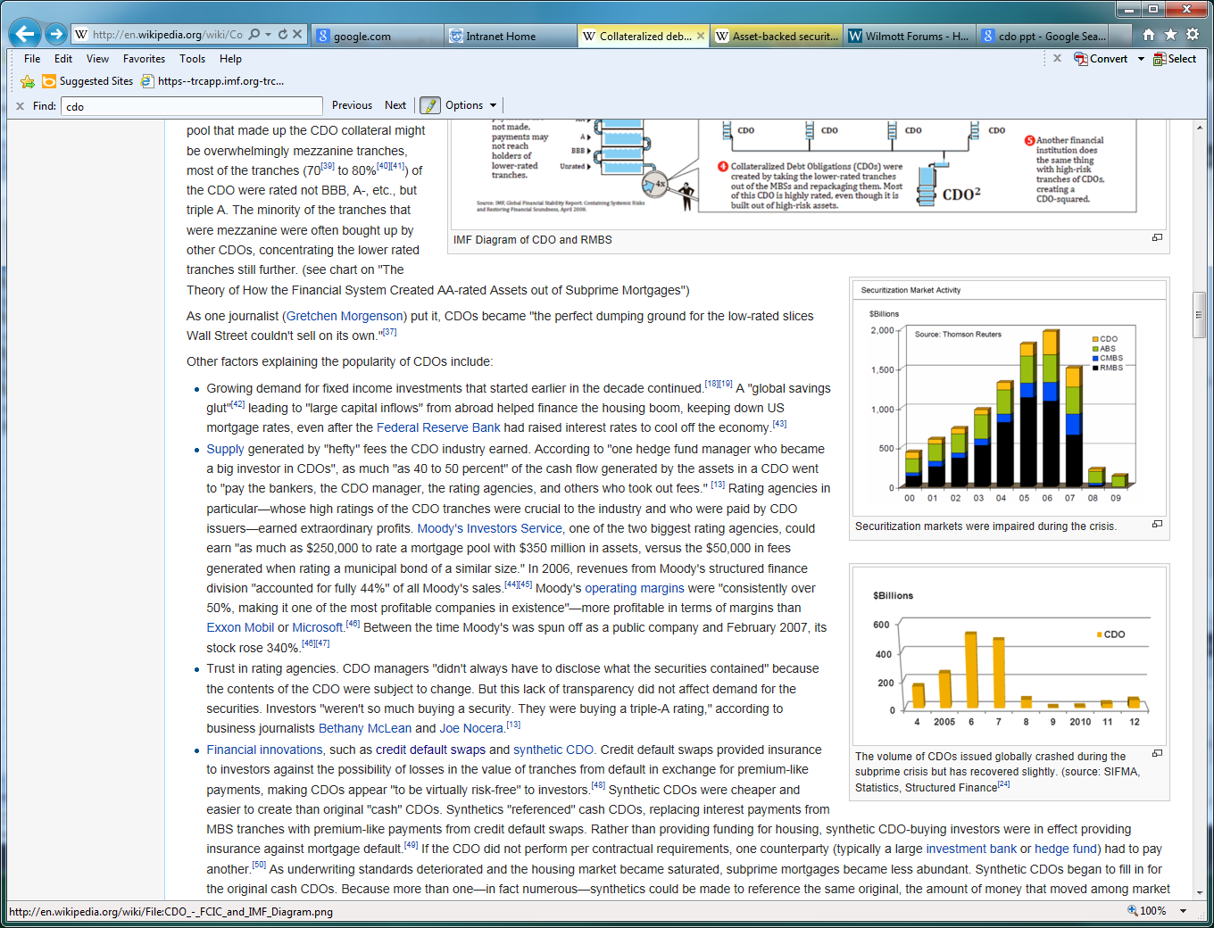
CDO Market Share

Slide 15
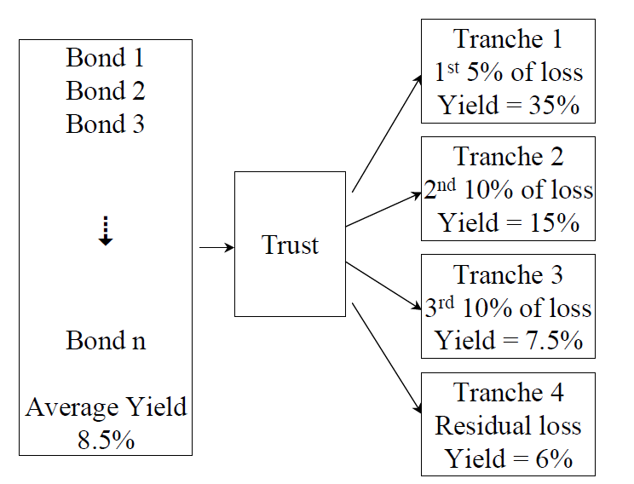
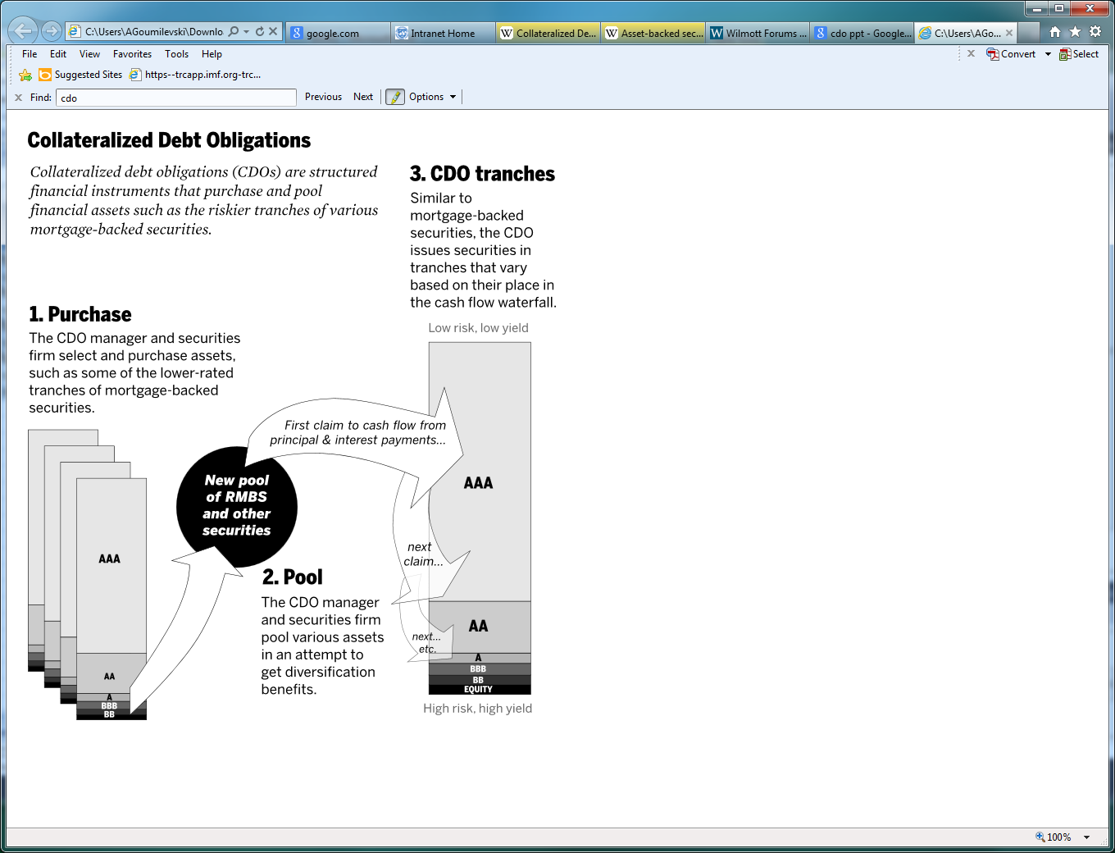
Structure of CDO

Slide 16
iTraxx Index
CDS index covers regions of Europe, Japan and non-Japan Asia.
iTraxx Europe is composed of the most liquid 125 CDS referencing European investment grade credits.
Constituents of this index are changed (rolled over) every six months on March 20th and September 20th.
Index quotes are provided by Markit Ltd. (see)
Family | Type | Index name | Number of entities | Description
Europe | Benchmark Indices | iTraxx Europe | 125 | Most actively traded names in the six months prior to the index roll
 |  | iTraxx Europe HiVol | 30 | Highest spread (riskiest) non-financial names from iTraxx Europe index
 |  | iTraxx Europe Crossover | 75 | Sub-investment grade names
 |  | iTraxx LEVX | 40 | European 1st Lien Loan CDS
 | Sector Indices | iTraxx Non-Financials | 100 | Non-financial names
 |  | iTraxx Financials Senior | 25 | Senior subordination financial names
 |  | iTraxx Financials Sub | 25 | Junior subordination financial names
 |  | iTraxx TMT | 20 | Telecommunications, media and technology
 |  | iTraxx Industrials | 20 | Industrial names
 |  | iTraxx Energy | 20 | Energy industry names
 |  | iTraxx Consumers | 30 | Manufacturers of consumer products
 |  | iTraxx Autos | 10 | Automobile industry names

Slide 17
Monthly iTraxx Tranche for March 28th, 2013
iTraxx Europe Series 15 Version 1 (RED Code: 2I666VAV7) (http://www.creditfixings.com/CreditEventAuctions/itraxx.jsp)
Tranches 0-3, 3-6 are up-fronts with a fixed 500bps spread, Tranche 6-9 has a 300bps fixed spread. Tranches 9-12, 12-22, 22-100 are up-fronts with a fixed 100bps spread.
Tranche | 5 Yr | Upfront (Bp) | Bid (Bp) | Mid (Bp) | Ask (Bp) | Dealers
Equity | 0%-3% | 500 | 3331 | 3481 | 3631 | 3
Junior Mezzanine | 3%-6% | 500 | 150 | 300 | 450 | 1*
Senior Mezzanine | 6%-9% | 300 | -75 | 75 | 225 | 1*
Junior Senior | 9%-12% | 100 | 149 | 174 | 199 | 1*
Senior | 12%-22% | 100 | 63 | 80.5 | 98 | 1*
Super Senior | 22%-100% | 100 | 15 | 17.5 | 20 | 1*

Slide 18
CDX Index
CDS index covers regions of North America and Emerging Markets.
CDX.NA.IG is composed of equally weighted 125 CDS investment grade CDSs.
A new series of CDS indices is issued every six months by Markit Group Limited. This process is intended to ensure that the index does not become "cluttered" with instruments that no longer exist, or which trade extremely with low liquidity.
Index Name | Number of entities | Description
CDX.NA.IG | 125 | Investment grade CDSs
CDX.NA.IG.HVOL | 30 | High Volatility investment grade CDSs
CDX.NA.HY | 100 | High Yield CDSs
CDX.NA.HY.BB | 37 | Index of high yield CDSs with a BB rating
CDX.NA.HY.B | 46 | Index of high yield CDSs with a B rating
CDX.NA.XO | 35 | CDSs that are at the crossover point between investment grade and junk
CDX.EM | 14 | Emerging market CDSs
CDX.EM Diversified | 40 | Emerging market CDSs
LCDX | 100 | NA First Lien Leverage Loans CDSs

Slide 19
Pricing CDO Tranche
Premium leg:
Discount factor:
Default leg:
Expected loss:
Given portfolio cumulative loss distribution function F,

Slide 20
One Factor Model
We assume that portfolio of referenced assets consists of N financial
instruments. Asset return is described by common and idiosyncratic risk factors:
Assume that default occurs when the asset return crosses the threshold ,
which is implied by obligor’s default probability:
Issuer defaults if,
Probability of default conditional on common factor M is,

Slide 21
One Factor Model
Probability that k out of N issuers default is,
Cumulative probability of percentage loss net exceeding is,
Cumulative distribution of losses for a large homogeneous portfolio is,

Slide 22
Gaussian Distribution
Plugging in Gaussian distribution in equation for tranche losses, we get:
Here is the cumulative normal distribution, is the cumulative bi-variate normal distribution, and is the covariance matrix:

Slide 23
Normal-Inverse Gaussian Distribution
NIG distribution is fat-tailed and skewed. Its probability density function is,
Here , and is the modified Bessel function of the third kind,
Parameters: - location, - tail heaviness, - asymmetry, - scale
Moments:

Slide 24
Monte Carlo Algorithm
Find Cholesky decomposition A of correlation matrix R=AA*.
Simulate n independent random variables Z = (Z1, Z2, … , Zn)’ from normal distribution, where n is the number of paths.
Let Y=AZ, then Y follows multivariate normal distribution with correlation R.
Obtain default times (T1, T2, … , Tn) by mapping back the Y’s to the T’s by using equation, for default probability, where is the cumulative normal distribution function.
Select subset of default times that are smaller than simulation time t.
Compute cumulative loss of portfolio of M names,
Compute each tranches loss, default and premium legs.
Compute breakeven spreads.

Slide 25
Bank Capital Regulation (Basel II Internal Ratings Based Approach)
α- Percentile of the loss fraction distribution of a Large Homogenous Portfolio:
Capital requirement:
Correlation:

Slide 26
Bank Capital Regulation

